Slide 1
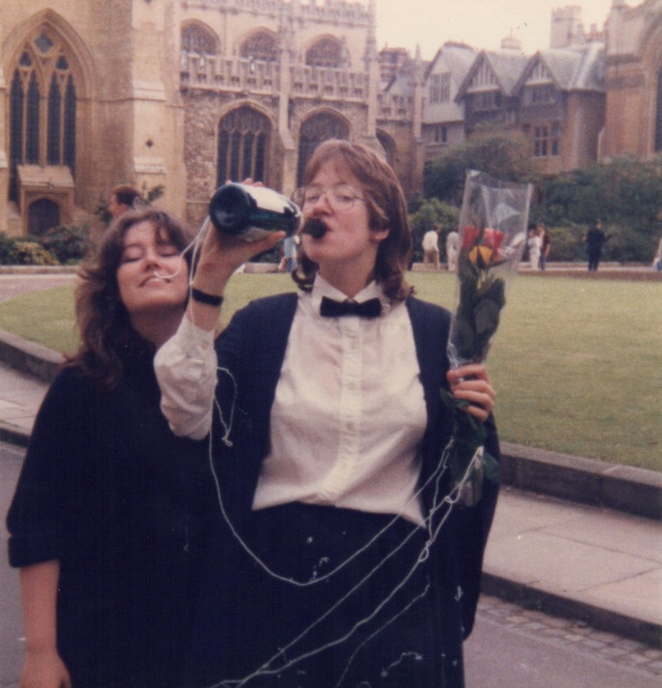
Choice & Balance
Fran Bryden
(English, 1982-85)

Slide 2
The Survey – 67 respondents

Slide 3
Balancing caring, work & study
19 respondents have a part-time job
18 of these are also looking after children…
Fewer than 20% of respondents looking after children had no other commitments to work or further education.
Around 15% of respondents are currently caring for older relations.
About 10% of respondents are involved in Further Education

Slide 4
“I chose my current job / role to improve my work / life balance.”
1 – Strongly Disagree 3 – Neutral 5 – Strongly Agree

Slide 5

“I currently have enough time and space to pursue my personal interests and passions.”
1 – Strongly Disagree 3 – Neutral 5 – Strongly Agree

Slide 6
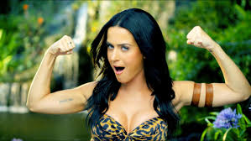
“I have had to work harder than my male counterparts.”
1 – Strongly Disagree 3 – Neutral 5 – Strongly Agree

Slide 7
Looking back…
1 – Strongly Disagree 3 – Neutral 5 – Strongly Agree

Slide 8
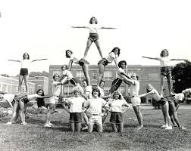
Confident balance…

Slide 9
Confident balance…
“Be brave…”
“There isn’t one right path”
“Be a present mother and use your brain”

Slide 10
Don’t worry, be happy…
Do you have a problem in your life?
No.
Then don’t worry.
Yes.
No.
Can you do something about it?
Yes.

Slide 11
Don’t worry, be happy…
“Listen to your instincts”
Do you have a problem in your life?
No.
Then don’t worry.
Yes.
No.
Can you do something about it?
Yes.
“Don’t compromise on your happiness”
“You’ve got nothing to prove…”

Slide 12
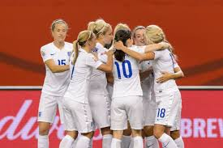
Goals & work…

Slide 13

Goals & work…
“Work out what you love doing…”
“Think of the future…”
“Grab all opportunities available to you”

Slide 14
Time to share…
Confident balance…
Don’t worry, be happy…
Goals & work…

Slide 15

Time to share…
Confident balance…
Don’t worry, be happy…
Goals & work…

Slide 16
What next?
THANK YOU!

