Slide 1
St John’s College - welcome!

Slide 2
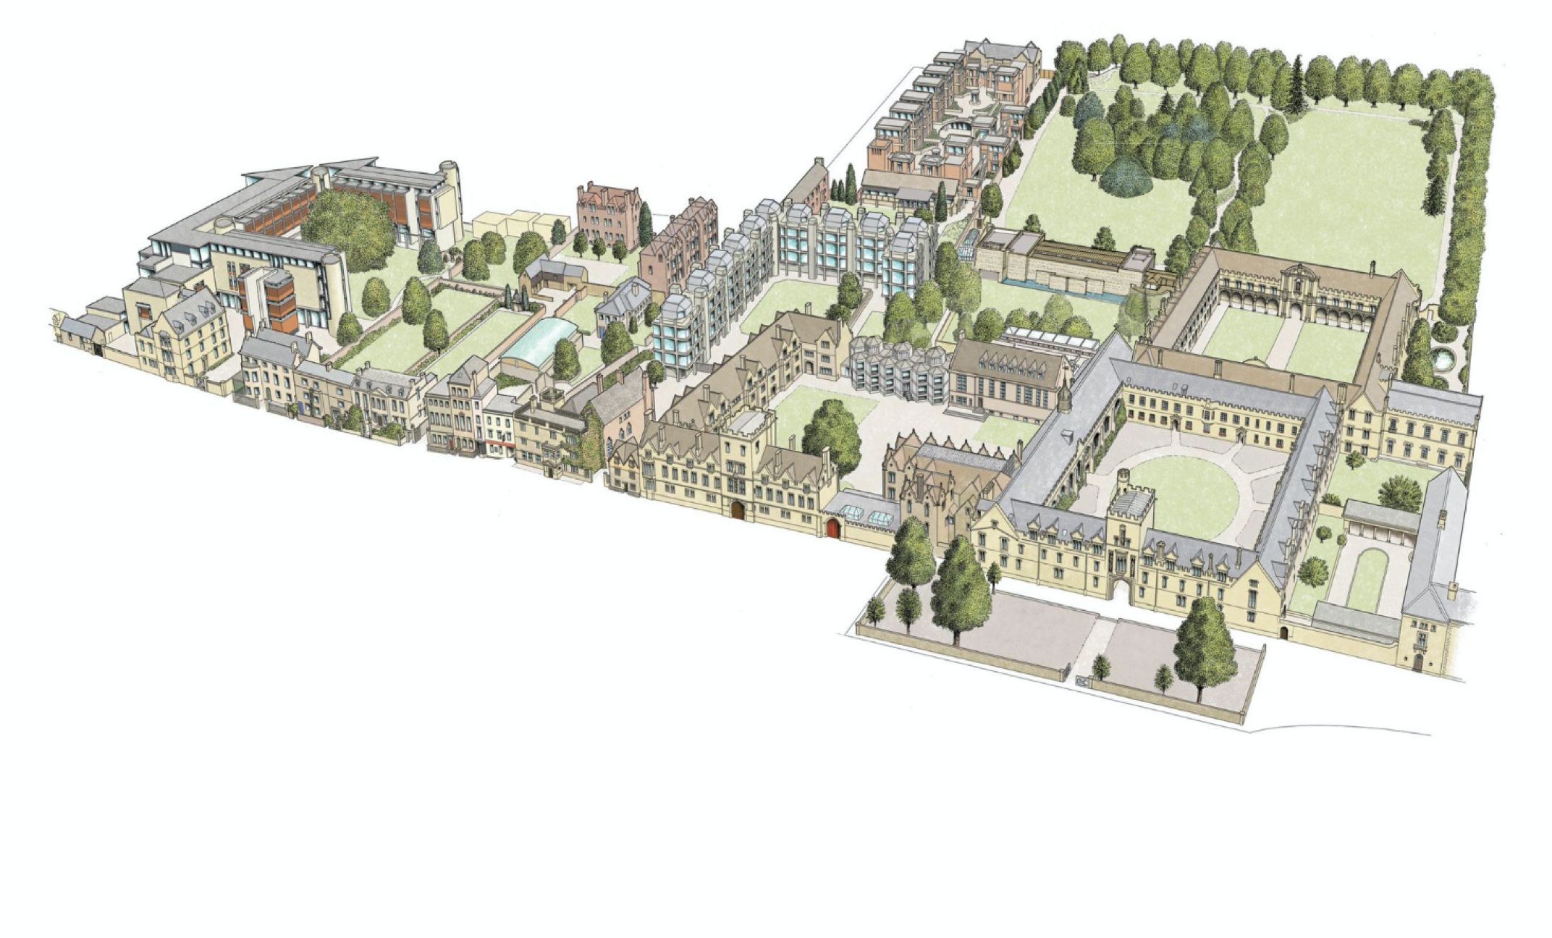
St John’s College - College site

Slide 3
St John’s College strategic plan - College goals
To foster excellent academic performance to enable research and scholarship to flourish.
To admit students with the highest academic potential regardless of background.
To provide teaching and facilities to enable students to fulfil their potential.
To ensure the welfare and well-being of a diverse college community.

Slide 4
Who is St John’s? College people
c.100 members of academic staff
Tutors
Researchers
Some College Officers:
c.420 undergraduates
c.250 graduates
JCR
MCR
President
&
Governing Body
Senior Dean
Head of Wellbeing
Senior Tutor
c.200 members of staff
Academic Office
Accounts, Domestic Office
Kitchen, Scouts
Porters, Works
Library, IT…
Alumni

Slide 5
Who is St John’s? College people
Academic Office
•University cards
•Examinations
•Disability support (Elaine Eastgate)
•Course changes etc
Academic administrator:
Eileen Marston
Accommodation Office
• Room allocation
• Anything related to your accommodation
Accommodation and Domestic Officers:
Robert Rusu, Mags Robertson and Nadine Hainge
Graduate Officer:
Caroline Lordan
College Lodge (Porters)
•Post
•Keys
•Emergencies
lodge@sjc.ox.ac.uk
Finance Office
•Collect fees and charges
•College grants
Accounts team: Michelle Murray
battels@sjc.ox.ac.uk

Slide 6
St John’s College - people
Library
•Advice on sources
•Book requests
Librarian: Petra Hoffman
Head of Wellbeing:
Hanne Clark
Fellow for Welfare:
Prof Katherine Southwood
Chaplain:
Rev’d Dr Elizabeth McFarlane
IT Support
• Help with computing
• Office in Rural Economy Quad
Senior IT officer: Matt Jennings
It-support@sjc.ox.ac.uk
MCR President:
Bomikazi Lupindo

Slide 7
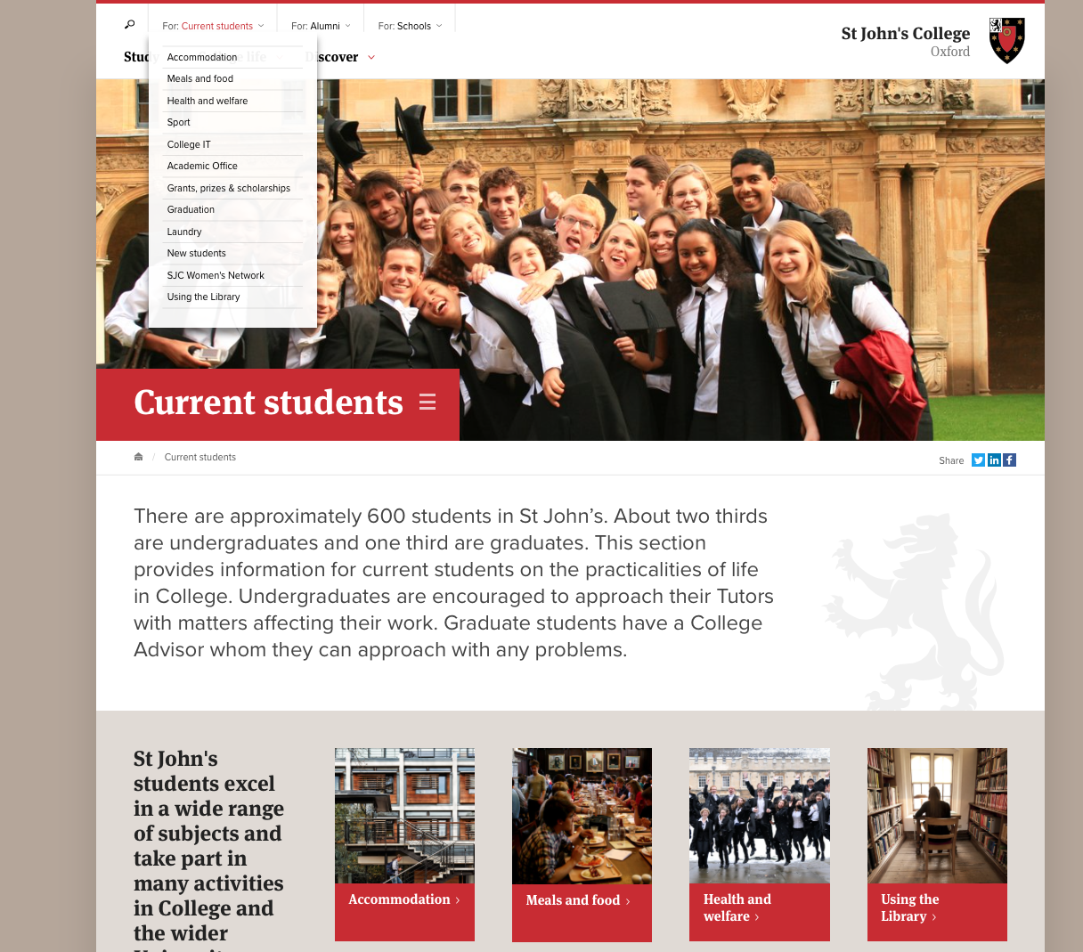
St John’s College - further information
Oxford University Student Handbook
Your course handbook from your department
College Domestic Arrangements Guide
MCR Freshers’ Guide
University new students page and Glossary of Oxford terms
Welcome information on College website including College handbook, etc

